Slide 1
Understanding Dimensions and measures
26/3/2019

Slide 2
Learning Objectives
Difference between dimension and measure
Apply dimension and measure to visualization
Type of the chart to use, based on dimension and measure
Alternative dimension and measure

Slide 3
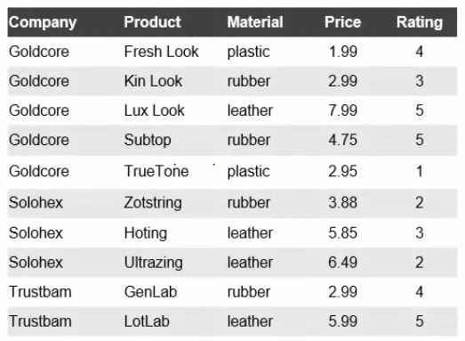
Sample data
Consider a sample data of company manufacturing smart phone cases.

Slide 4
Bar Chart
From the given sample, let us discuss the visualization, that answers a series of questions
The first question to be asked is “How much each product costs?”
For this ‘Product’ is taken as Dimension and ‘Price’ is taken as Measure.
Using one dimension and one measure, we can go for “Bar Chart”

Slide 5
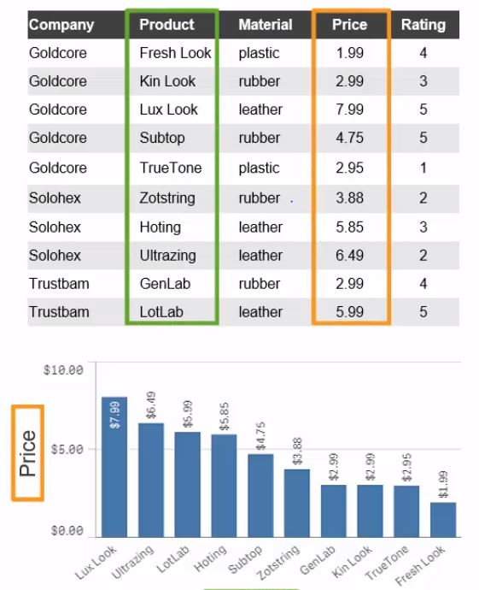
Bar Chart

Slide 6
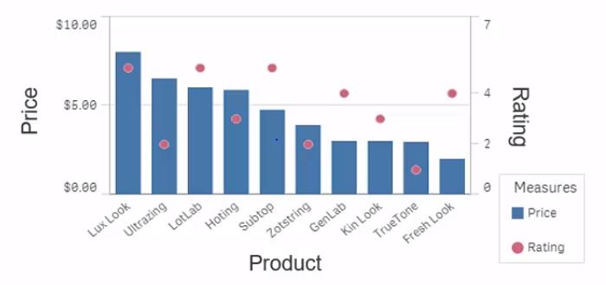
Combo Chart
If we need to show both the rating and price of a product in the same chart, we can go for “Combo chart”

Slide 7
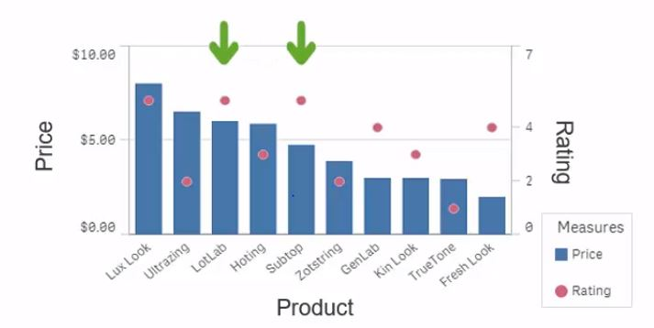
Analysis
From the “Combo chart” we can conclude that instead of buying “Lux Look” which has high rating and costs high, we can opt for either ‘Lotlab’ or ‘subtab’, which has the same rating and low in cost.

Slide 8
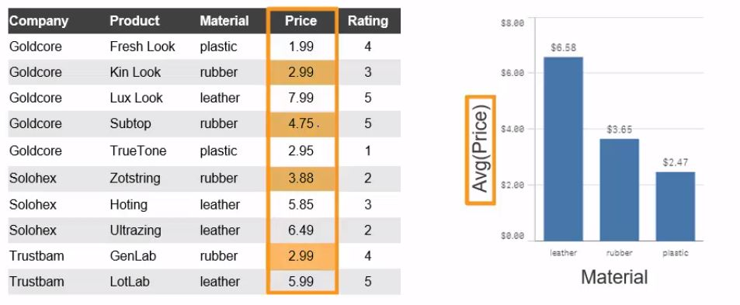
Aggregation
Applying aggregation will group values of same group. For example, finding average price of the different materials.

Slide 9
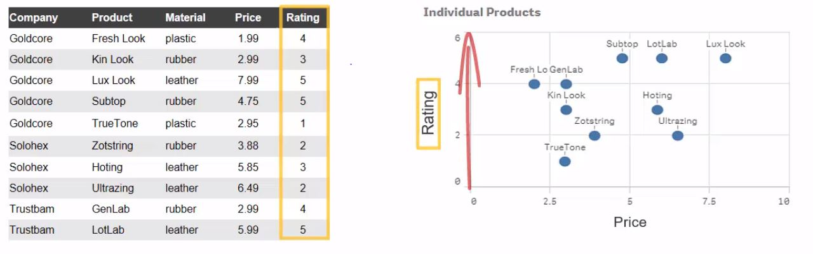
Scatter plot
Scatter plot determines a dimension in a bubble, against two measures (price and rating). The position of the bubble is the intersection point of those 2 measures.

Slide 10
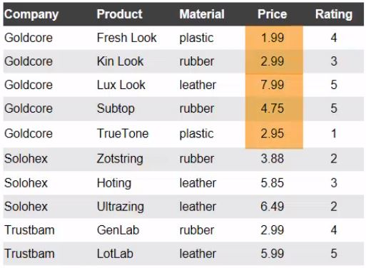
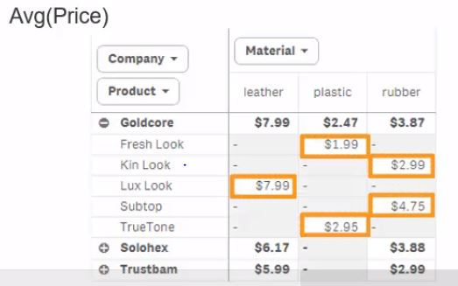
Pivot table
Pivot table can group values on two or more dimensions and displays results in a table format.

Slide 11
Sample Dashboard
Let us discuss some of the visualization concepts from the sample dashboard shared “Examples of Applied Dimensions and Measures.qvf”

Slide 12
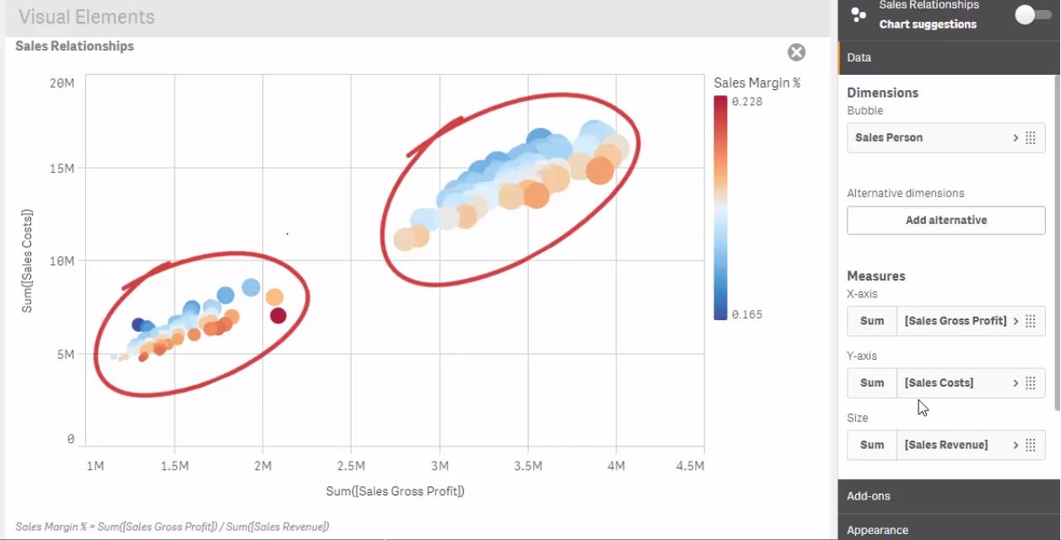
Scatter plot

Slide 13
Analysis
The x and y-axis of the scatter plot are two measure values namely “Sales Gross Profit” and “Sales cost”.
The bubble is the dimension, and it’s position is based upon it’s measure values.
From the graph, it is evident that the data cluster occurred is differentiated into two different groups.
And the linear relation between two axis is visible, and differentiated into 2 colors, which indicates more sales have to occur for more profit to obtain.
It also configured by the 3rd measure called Sales revenue, which indicates the size of the bowl.

Slide 14
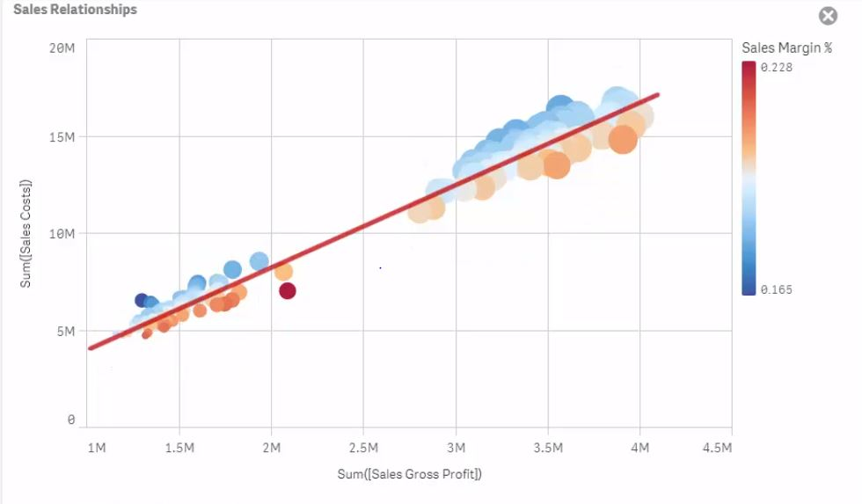
Analysis

Slide 15
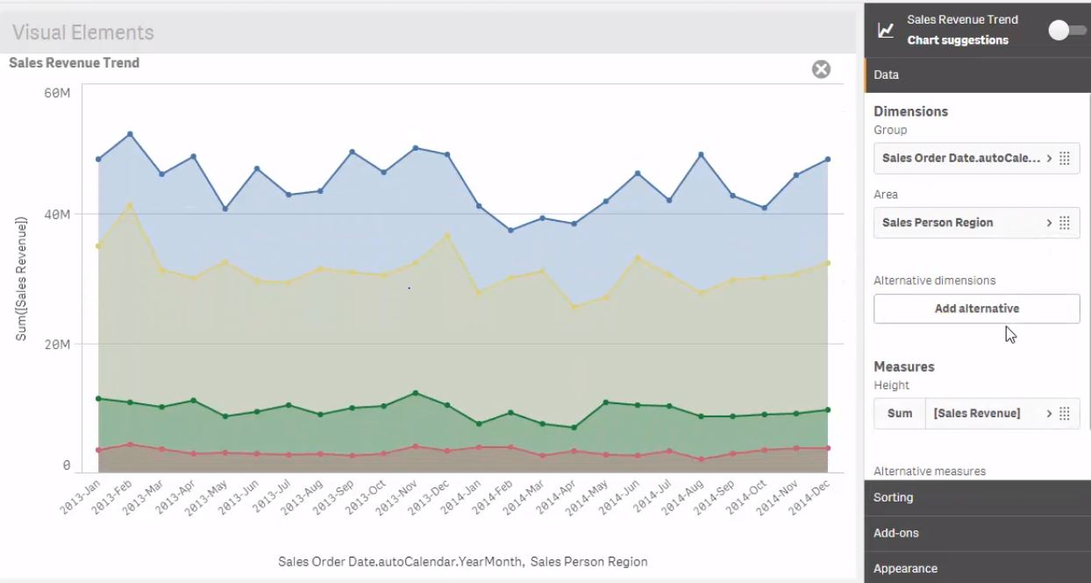
Line chart

Slide 16
Analysis
Line chart is usually plotted against one dimension and one measure.
However in the data field on properties, there will an ‘Add’ button in both dimension and measure, which allows user to add more dimension and measure to it.
When we add one more dimension, the ‘Add’ button in measure will disappear, which don’t allows user to add 2 measures when 2 dimensions are applied. Similarly adding 2 measures will prevent user from adding the 2nd dimension. However, more measures can be added with 1 dimension.
To conclude, line chart allows either “2 dimensions and 1 measure” or “1 dimension and multiple measures”

Slide 17
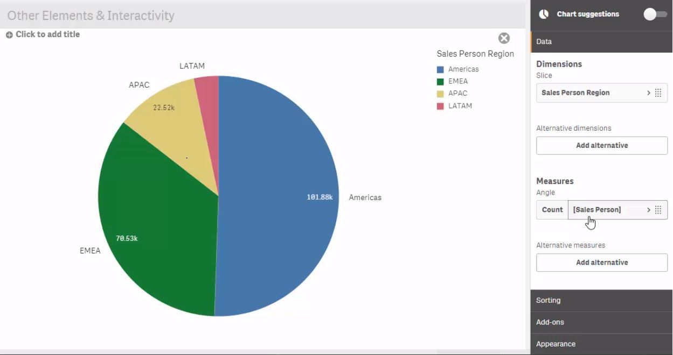
Pie chart

Slide 18
Analysis
Pie chart is plotted against 1 measure and 1 dimension.
The partition is determined by dimension and the size of the partition is determined by it’s measure value.
For example if we add, count(sales person) in measure, it shows 101.88k for America alone. But we are clear from the fact that no such high number of sales person were in that region.
To overcome this, we need to add ‘Distinct’ in the expression, to count only the unique names in the “sales person”

Slide 19
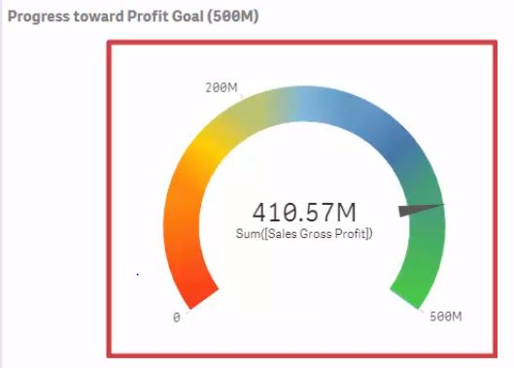
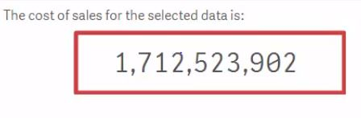
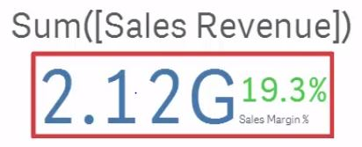
Gauge, KPI, Text and image chart
There are 3 charts which is used to show the measure value alone.

Slide 20
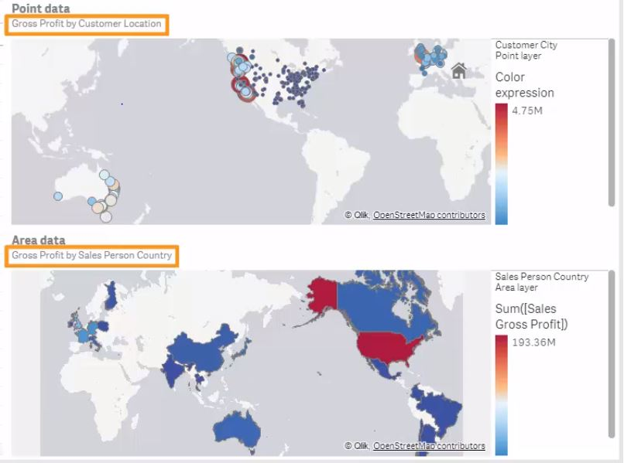
Maps

Slide 21
Analysis
Maps can be used to display data in geographical region.
The data displayed can be either a point data or an area data.
The size of the bubble in the point data defines the magnitude of it’s value.

Slide 22
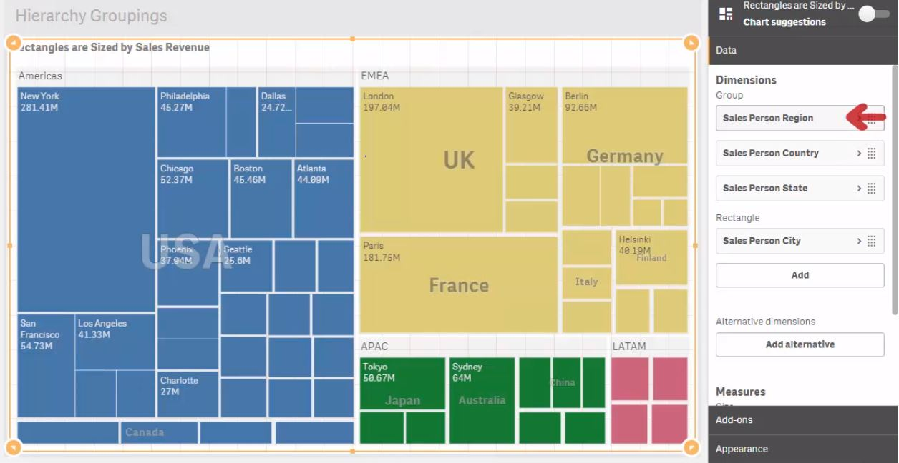
Tree map

Slide 23
Analysis
Tree map is plotted against 1 measure value with multiple dimensions.
It allows user to add multiple dimension, but only 1 measure value.
It is best suited for hierarchical data like region -> Country -> State -> City.

Slide 24
Drill Down
As we all know the limitations of a bar chart, that it allows only maximum of 2 dimensions, what if we want to use multiple dimension in a single bar chart?
These kind of requirements were mostly seen in hierarchical data, as it may drilled down to get the detailed value of it.
To create Drill down, open master items -> Dimension -> Drill down. Add the dimensions in the hierarchical manner you need it to be and label it.
We can use that as a single dimension and the drill down option will be seen at the axis label in visualization.
We can also create master measure value like Margin%.
Margin% = Sales Gross profit/Sales Revenue.

Slide 25
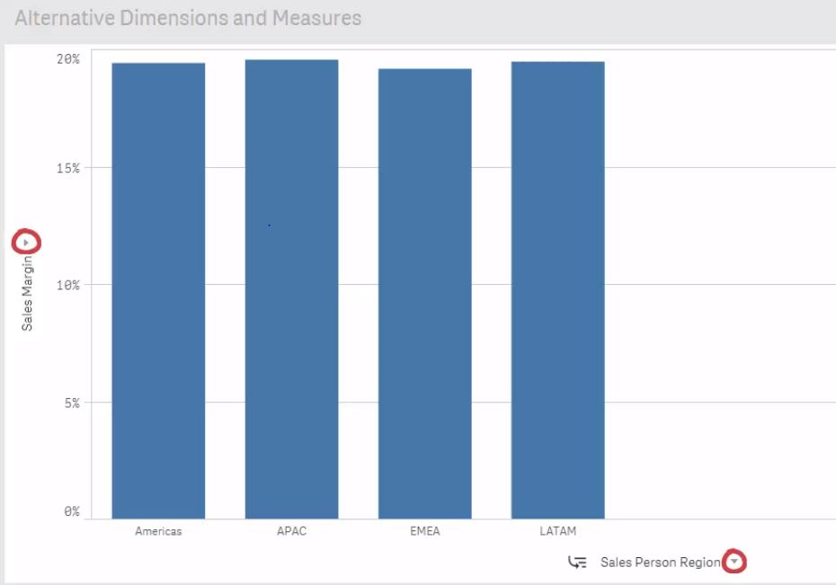
Alternative Dimensions and Measures

Slide 26
Analysis
In Data field on properties, under dimension and measure, there will be an option called “Add Alternatives”
We can create alternative dimension and measure using that.
Creating an alternative won’t have an impact on the visualization. But you can find two drop drown button in the axis label.
By clicking on that, you can switch from one measure to another and same for dimensions.
After switching from one measure to another, if we press edit, it will ask for applying the changes made.

Slide 27
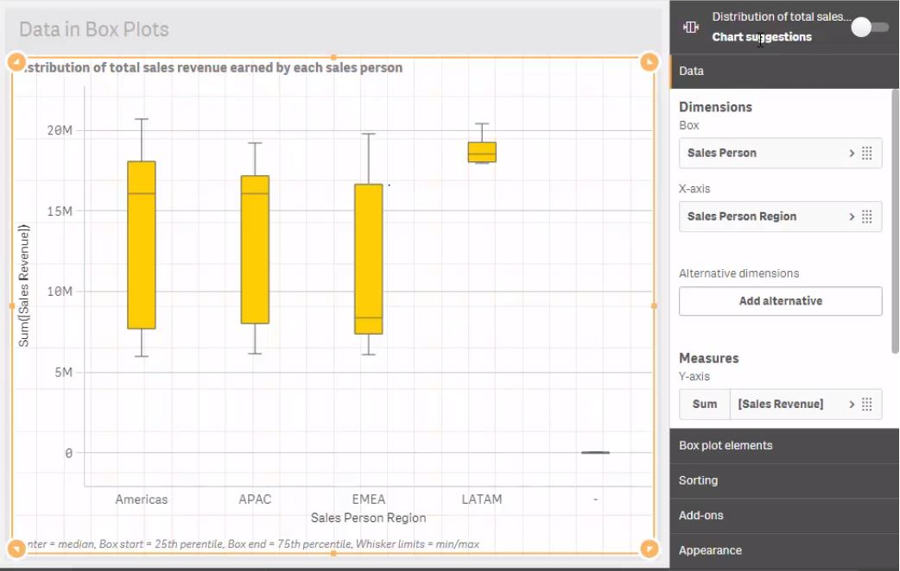
Box Plot

Slide 28
Analysis
Box plot can feature maximum of 2 dimensions and 1 measure.
The box is drawn using the 25th and 75th percentile value.

Slide 29
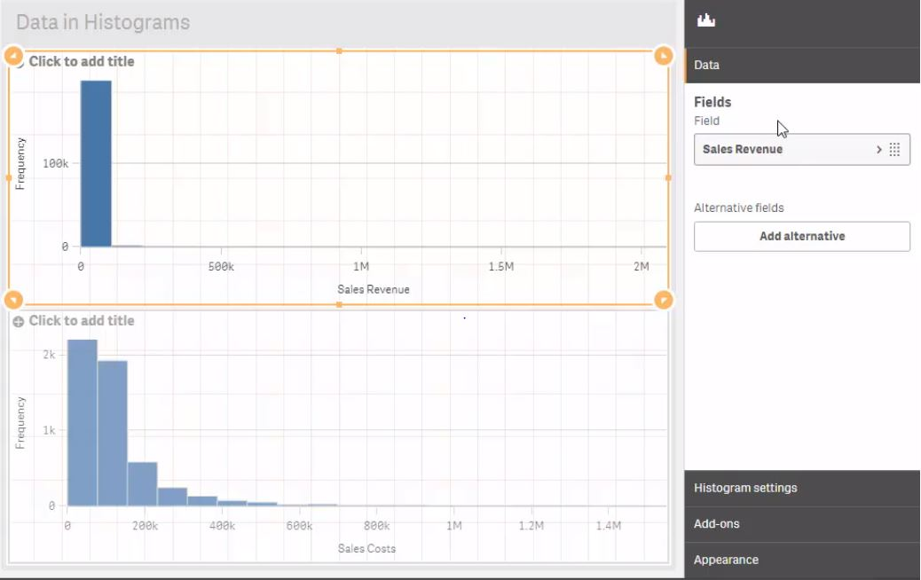
Histogram

Slide 30
Analysis
When creating histogram, it will ask for adding ‘Value’ instead of “Dimensions and measures” and the expected field is ‘Numerical’
It groups the value on it’s own and doesn’t follow the traditional grouping method

Slide 31
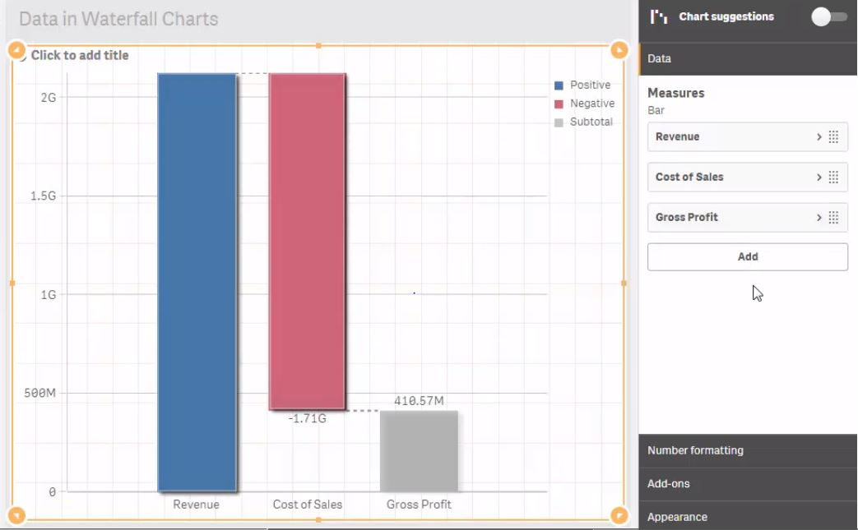
Waterfall Chart

Slide 32
Analysis
Waterfall chart can be used on two or more measures, but no dimensions can be used.
Selections won’t work on bars.

Slide 33
Recap - Dimensions
Dimensions are categorical data which groups data from the underlying data model.
Dimensions selected for visualization will group values to define visual element. Those elements are:
‘Bars’ in Bar chart.
‘Markers’ in Combo chart
‘Bubbles’ in a scatter plot
‘Points’ on a line
Pie sectors
‘Treemap’ rectangles
Individual values
‘Cell value’ in table or pivot table

Slide 34
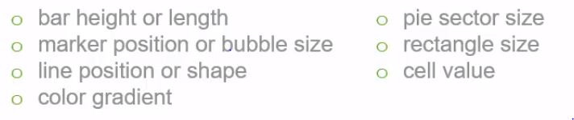
Measures
Measures will define the magnitude of the visualization elements.
The magnitude is based on the aggregation done. The common aggregations are Sum, Count, Average.
The visual elements are:

